Slide 1
SEND Thresholds
Multi Agency and Families Launch
January 11th and 12th 2024

Slide 2
Outline of the session
Introduction and rationale
To understand how the SEND Thresholds have developed in Gateshead and how it will continue to evolve
Parent/carer voice
To understand how to use the SEND Thresholds and multi-agency working
Q&A

Slide 3
SEND Thresholds – 0-25 years
Graduated Approach to identifying and meeting needs
Consistency of approach across all agencies – improving transition
Common language for families, young people and professionals
Clarity over access to range of support across all agencies
Extensive information on ‘making this happen’ across education, health and social care
In depth guidance and expectations on the delivery of support and quality interventions in settings, schools and Post 16
Focus on the 4 areas of need from the SEND Code of Practice and Preparation for Adulthood (PfA) outcomes
Notes:
Anne

Slide 4
National Agenda
SEND
An Overview
March 2023
Notes:
Anne

Slide 5
Notes:
Anne

Slide 6
Notes:
Anne

Slide 7
Notes:
Anne

Slide 8
Notes:
Anne

Slide 9
SEND Thresholds development and plans

Slide 10
Consultation and co-production
A range of multi agency professionals, including 40 pilot settings, SEND Support Services, CYPS, Therapy services, Paediatric consultant, Early Help and social care
Helped to shape the document to represent the landscape of provision in Gateshead
Voices of parents/carers and children and young people
Officially launched in Gateshead on 11th January 2024 – full document available online on Gateshead Local Offer Education - Gateshead Local Offer SEND 0 to 25 years (gateshead-localoffer.org)
Notes:
Sam

Slide 11
The pilot school program
Chris Boddy from Rowlands Gill Additionally Resourced Mainstream School (ARMS) working predominately with Primary Schools and Early Years providers
Amanda Miller from Brighton Avenue Primary School working predominately with Primary Schools
Nadine McCarthy from Lord Lawson of Beamish Academy working predominately with Secondary Schools and Post-16 settings
Samantha Leaver working predominately with Specialist settings
Notes:
Sam

Slide 12
The pilot school program – Chris Boddy
Colegate Primary
Harlow Green Primary
Highfield Primary
High Spen Primary
Kells Lane Primary
Rowlands Gill Primary
Rowlands Gill U5’s
Washingwell Primary
Whickham Front Street Primary
Whickham Parochial U5s
Notes:
Chris

Slide 13
The pilot school program – Chris Boddy
Each school at different stages and implementing Thresholds in their own way (context dependent).
Early Years vs Primary / Secondary…much discussion! 0-5 Years.
School / U5s concerns around support plans – evidence, documentation and workload.
PfA…how we provide opportunities / targets / ARMS
Parental involvement key – collaborate to get full, accurate picture …then get best provision possible
Importance of ‘whole school-ness’ – applies to any setting. Everyone has a role to play. Leadership support is essential
Notes:
Chris

Slide 14
Pilot schools – Amanda Miller
Bensham Grove Nursery
Brighton Avenue Primary
Caedmon Primary
Carr Hill Primary
Kelvin Grove
Riverside Academy
St Aidans
St Augustines
Wardley Primary
Notes:
Amanda

Slide 15
Pilot schools – Amanda Miller
How schools have a approached the thresholds and where we’re up to…
Networking and Moderation events
Feedback from pilots and associated changes made to the document
Service involvement- linked to what we have in Gateshead
Parent/carer accessibility and parental expectations
Whole school approach and SLT support
Notes:
Amanda

Slide 16
Pilot schools – Nadine McCarthy
Birtley East Primary School
Gateshead College
Heworth Grange School
Kingsmeadow Community School
Larkspur Primary School
Lord Lawson of Beamish Academy
Newcastle College
Portobello Primary School
XP Gateshead
Notes:
Nadine

Slide 17
Pilot schools – Nadine McCarthy
Approaches taken across different age settings
Transitions and Consistency on entry and exit to the Secondary setting
Important role of PfA and shifting emphasis to transition at Post 16
Whole school approach and a workload emphasis/awareness
Links to agencies
Notes:
Nadine

Slide 18
Pilot schools – Sam Leaver
Bede Primary ARMS
Cedars Trust
Delly Bears
Dryden School
Eslington School
Furrowfield School
Gibside School
Haskel
Howard House
Lobley Hill ARMS
River Tyne MAT
Swalwell Primary ARMS
Notes:
Sam

Slide 19
Pilot schools – Sam Leaver
Training and additional documents to support understanding of referral process
PVI and childminders SEND conference event in April
Cedars and Gibside opened their doors for all pilot settings to explore provision for CYP within the higher Thresholds
Refinement of Thresholds 4b+ with work ongoing, particularly in Cognition and Learning
Assessment development to provide a toolkit
Ongoing work on a preparation for adulthood curriculum and careers document which has additional cultural dimensions for the Jewish community
Notes:
Sam

Slide 20
Pilot schools – Anne Hayward
Learning & Skills
Virtual School
Notes:
Sam

Slide 21
Implementation and next steps
Autumn 2 information sharing with SENDCo clusters
Spring 1 SEND Thresholds document launch on Local Offer, booklet will be delivered to settings/services, additional documents published, SENDCo surgeries bookable through SENDCONetwork@gateshead.gov.uk
Spring 2 online training offer available, linked support plans and referral documents
Summer 1 embedding Thresholds into everyday practice
Summer 2 moderation across the authority
Autumn 1 SEND Thresholds will be compulsory
Ongoing evolution of the document
Notes:
Sam

Slide 22
Parents/carers voice and experiences

Slide 23
Parent/carer document
The Graduated Approach
Sean Grey has worked with the Gateshead PCF to collect their views and experiences which has been collated into a booklet alongside links to support services for parents and carers
This has then shaped a section in the document on best practice when working with children/young people and their families

Slide 24
The Graduated Approach

Slide 25
Involving children and young people

Slide 26
Children and young people
Harry Vincent has created two videos, one for primary and one for secondary, to introduce the SEND Thresholds to children and young people SEND Thresholds - Gateshead Local Offer SEND 0 to 25 years (gateshead-localoffer.org)
A section in the SEND Thresholds with the voices and experiences of children and young people to help us reflect on how we involve and work with them. A video version of this has also been made Gateshead SEND Thresholds - Young People's Voice - YouTube
Notes:
Sam

Slide 27
The Graduated Approach
Notes:
Sam

Slide 28
Services in the SEND Thresholds

Slide 29
Notes:
Sam

Slide 30
Notes:
Sam

Slide 31
Notes:
Sam

Slide 32
Time for reflection, discussion and questions
Notes:
Anne Document given out

Slide 33
The SEND Thresholds and how to use them

Slide 34
Key terms
Services – includes Education, Health (mental and physical), Social Care, Speech & Language, Occupational Therapists and any other professionals working with the CYP
Quality First Teaching (QFT) – good teaching that is personalised and will meet the individual needs of the majority of children and young people in an inclusive classroom environment
Specialist provision – provision that is required to meet additional needs. Special educational provision is underpinned by high quality teaching and is compromised by anything less.
EHCP – Education Health Care plan. A legal document which identifies a CYP's special educational needs and the additional or specialist provision (support, therapy etc) required to meet their needs.
Notes:
Anne

Slide 35
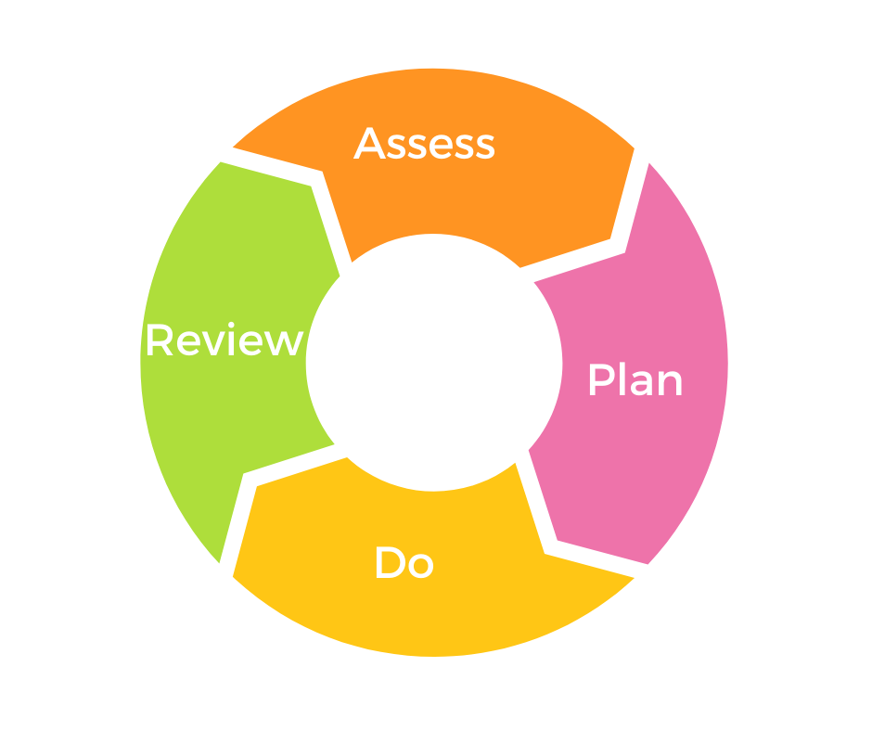
The Graduated Approach
Areas of Need
The SEND Code of Practice (2014/15) highlights four broad areas of SEND needs:
Communication and interaction
Cognition and learning
Social, emotional and health difficulties
Sensory and/or physical needs
Preparation for Adulthood
Notes:
Anne

Slide 36
What are the SEND Thresholds?
Essentially, the Thresholds are a breakdown of the levels of need a child or young person (CYP) may experience. The Thresholds progress from 1 to a maximum of 7 - the higher the Threshold, the higher the level of need and, therefore, the higher the level of intervention required, possibly from a range of services.
They are intended to enable people to make both an accurate identification of needs based on the presentation of the CYP and, crucially, an identification of appropriate types of specialist provision.
They are NOT a tick list! They are a basis for collaboration between school, CYP, parents/carers and services to form an accurate and full picture of a CYP’s level of need. This is then used to identify appropriate and realistic support.
Notes:
Anne

Slide 37
Using the SEND Thresholds
Quality First Teaching remains essential in providing a firm basis upon which to use the additional strategies identified at each ‘Threshold’. Strategies and advice from earlier ‘Thresholds’ need to be continued alongside new ideas and approaches from higher Thresholds – they don’t stop (especially QFT)!
Threshold 4 is where an EHCP would be considered. At Threshold 4 and above, the level of curriculum modification and personalisation increases notably, and the need for specialist provision and individualsed support from a range of professionals also increases.
Preparation for Adulthood needs to be embedded into the curriculum offer to support the development of skills that will allow them to succeed in life.
Notes:
Anne

Slide 38
How to use the SEND Thresholds
1. Have a summary discussion with all involved
Identify ‘Primary Area of Need’
Go to Overview page and read through
Then go to the identified number Threshold
Discuss…What are we doing / could we be doing?
Repeat for other areas of need
What is the CYP’s ‘profile’?
Update Support Plan / ILP
Continue ‘Assess, Plan, Do, Review’ cycle
Notes:
Chris

Slide 39
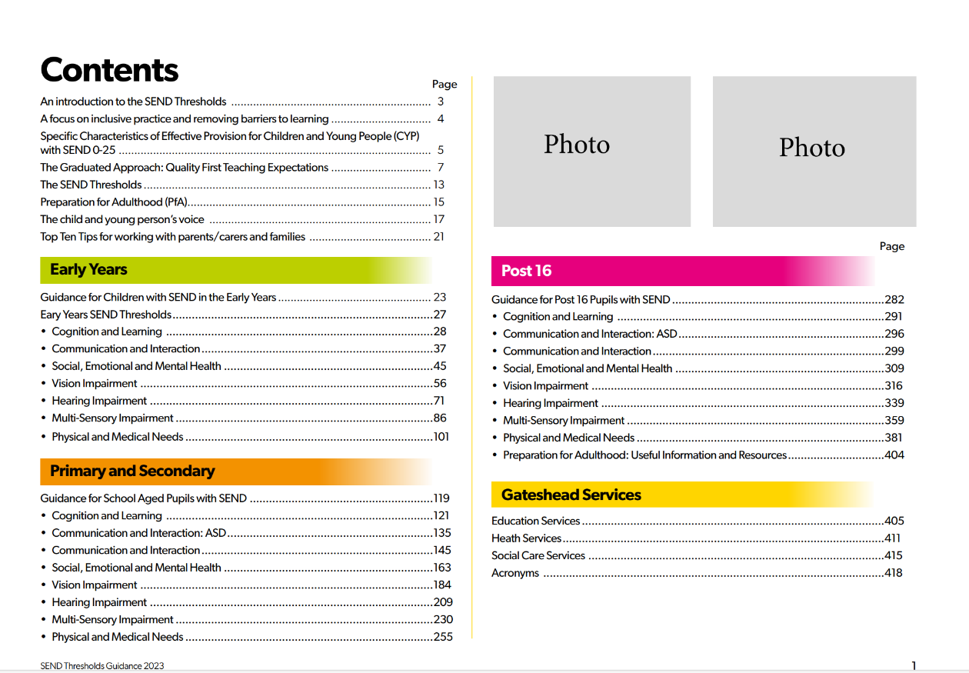
Notes:
Chris

Slide 40
Turn to page 121
Notes:
Chris

Slide 41
Turn to page 122
Notes:
Chris

Slide 42
Turn to page 123
Notes:
Chris

Slide 43
Turn to page 124
Notes:
Chris

Slide 44
Turn to page 128
Notes:
Chris

Slide 45
Turn to page 130
Notes:
Chris

Slide 46
Notes:
Anne

Slide 47
Notes:
Sam

Slide 48
Notes:
Sam

Slide 49
How to use the SEND Thresholds
Task 1
Think of a CYP who is known to you in your role
Using a copy of the Thresholds identify which Threshold the CYP predominantly sits in for their main area of need
Notes:
Sam

Slide 50
How to use the SEND Thresholds
Task 2
Questions to reflect on:
Were you surprised at the Thresholds you identified the CYP to be in? (Did you think it would be higher/lower?)
Did the child fit into one Threshold or multiple Thresholds?
How could you use the document to help you support CYP within your role?
Notes:
Sam

Slide 51
How to use the SEND Thresholds
Task 3
Thinking about how you will use the SEND Thresholds:
How will you implement it across your setting/service?
What else do you need to support you?
Notes:
Sam

Slide 52
Implementing the SEND Thresholds
You may want to:
Schools
Complete an audit with your SEND Governor/SLT
Start with one group/class in school and then roll it out
Use it to look at your SEND register and the provision offered
Services – Education / Health / Social care
Managers update teams on how use of the Thresholds will directly feed into specific roles and training needs
Parents/carers
Review with the school/setting what is in place and what else may support your CYP
Notes:
Sam

Slide 53
Summary
The SEND Thresholds will provide a framework for the graduated response in Gateshead.
They will improve identification of a CYP’s needs and provision or support required.
We will use them to provide consistency of judgement and provision across all services.
They require full and ongoing involvement of the young person and their parent/carers.
They will lead to improved transitions between academic phases, 0 to 18.
There will be a training program to support implementation, as well as personal support and advice.
They will evolve and be adapted over time as they are used.
Notes:
Anne

Slide 54
Any questions or points for discussion?
Notes:
Anne

