Slide 1

SENCO NETWORK MEETING
7th JULY 2022 3:30-5:00,
Streamlining paperwork- templates
Victoria Beattie-Kalmer Counselling
Lee Peacock-IAG
Dual diagnosis resources and the Autism Education Trust
Health Updates
Training and development- next academic year

Slide 2

Welcome to the All New SENCO Network
If you can, mobile phones off please
Your attention
Misery is optional
Add anything in chat
Ask any questions along the way

Slide 3
Welcome all……
Who is getting giddy and excited for the end of term? Spare a thought for those less fortunate than yourselves.
It has been a tough year in the world of SEND-hectic is one word I can use but I want to recognise all of the hard work and just say a huge thank you- you really are appreciated.

Slide 4
Our first guest speaker…….
Victoria Beattie from Kalmer Counselling

Slide 5
What is on offer?
The DOSE newsletter and FREE resources, which have been adapted to work within schools. Throughout COVID and beyond mental health has suffered and we are trying to make mental health positive. Kalmer Counselling have produced a FREE electronic magazine and website full of resources.
www.dosemagazine.co.uk
It is in continuous development and has a free activity pack- there are random acts of kindness, mirror mantras and support for all things mental health.
victoria@kalmercounselling.co.uk

Slide 7
Dual diagnosis Resources (Autism and ADHD):
North East Autism Society (ne-as.org.uk)
Home - ADHD Foundation : ADHD Foundation
Anna Freud National Centre for Children and Families

Slide 8
Autism Education Trust
They will help you improve the learning and wellbeing of autistic children and young people by supporting you to capture pupil voice, set suitable learning challenges, measure progress and identify areas where you or your setting can make improvements. The AET Framework documents can be used alongside Autistic pupils to support the development of good Autism practice.
The Progression Framework
This is an interactive assessment tool that helps practitioners identify learning priorities, set key learning intentions, and track progress for autistic pupils and young people in both mainstream and specialist educational provisions.
The Autism Competency Framework
Can be used by staff/practitioners as a self-evaluation tool to rate their understanding and knowledge of Good Autism Practice. There is one for Early years, Primary and Secondary AND Post 16.
The Autism Standards Framework
Can be used by leaders/leadership teams to support the implementation of Good Autism Practice across a whole organisation. There is a standards framework for Early Years, primary and Secondary and Post 16.
Framework Documents | Autism Education Trust

Slide 9
If you are from the NHS, education, local authority, healthcare or VCS sectors and would like to book a free Kooth and/or Qwell training session please get in touch, via the following email address
northteam@kooth.com
We have created the above new team email address to ensure your queries are directed to the right person on every occasion. Please use this address to make contact with us going forward.
We have a large selection of Kooth and Qwell resources, these can be found on Brandmaster, our online resource hub, this offers direct access to our full range of resources which can be used to complement your social media and online platform communications. Please find our easy to download assets here.
Links to podcasts, July events

Slide 10
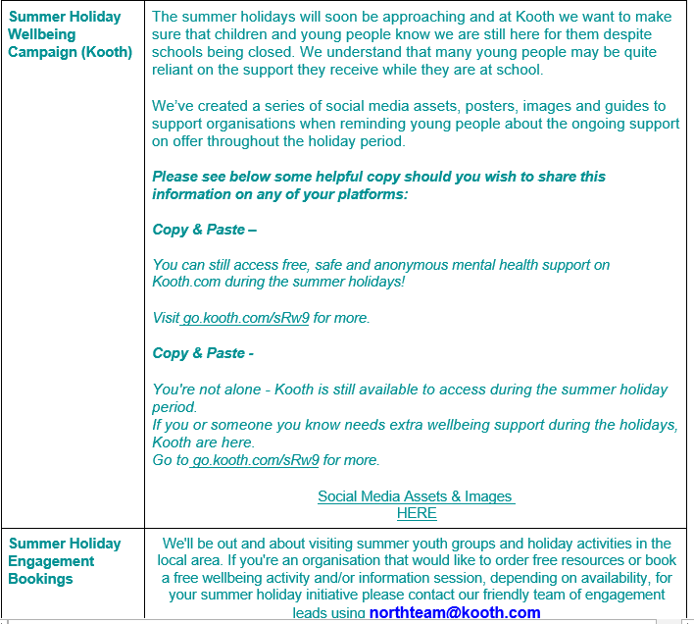
Summer Holiday Wellbeing Campaign (Kooth) | The summer holidays will soon be approaching and at Kooth we want to make sure that children and young people know we are still here for them despite schools being closed. We understand that many young people may be quite reliant on the support they receive while they are at school. We’ve created a series of social media assets, posters, images and guides to support organisations when reminding young people about the ongoing support on offer throughout the holiday period. Please see below some helpful copy should you wish to share this information on any of your platforms: Copy & Paste – You can still access free, safe and anonymous mental health support on Kooth.com during the summer holidays! Visit go.kooth.com/sRw9 for more. Copy & Paste - You're not alone - Kooth is still available to access during the summer holiday period. If you or someone you know needs extra wellbeing support during the holidays, Kooth are here. Go to go.kooth.com/sRw9 for more. Social Media Assets & Images HERE
Summer Holiday Engagement Bookings | We'll be out and about visiting summer youth groups and holiday activities in the local area. If you're an organisation that would like to order free resources or book a free wellbeing activity and/or information session, depending on availability, for your summer holiday initiative please contact our friendly team of engagement leads using northteam@kooth.com

Slide 11
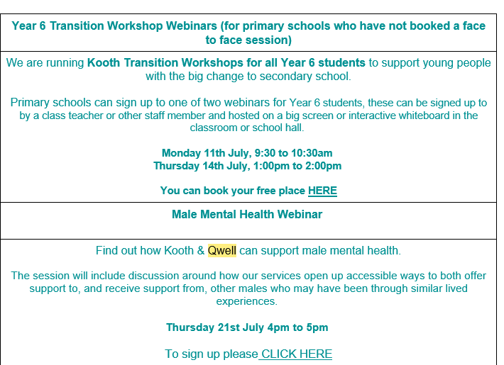

Slide 12
Our next guest…..
Lee Peacock from the IAG (Information, Advice and Guidance team). He is hear to talk to you about their offer and what they can provide.

Slide 13


Slide 14


Slide 15
Careers, Advice and Guidance
Work with Year 11 and Year 13 predominantly to deliver careers guidance and attending transitional reviews. They work with those individuals at risk of NEET (Not in Employment, Education or Training) as well as those in Education, Employment and Training.
Contact details: leepeacock@gateshead.gov.uk
0191 433 3856

Slide 16
Other LA Careers Teams
craig.liddle@durham.gov.uk
ann.graham@newcastle.gov.uk
sarah.lewthwaite@southtyneside.gov.uk
lindsey.taggart@northumberland.gov.uk
john.gibson@northtyneside.gov.uk

Slide 17
Streamlining paperwork
Would you like/ feel it would be beneficial to have a template for SEN support plans and behaviour plans or do you prefer using your own versions?
If you are interested in supporting us to make easy to use templates to support you then let me know as a task and finish group will be set up next academic year.
lynnekilford@gateshead.gov.uk or sendconetwork@gateshead.gov.uk

Slide 18
Health Updates from our Health Colleagues
Our new DCO……..Dawn Robson

Slide 19
Updates
CCG has now become the North East and North Cumbria Integrated Care Board (ICB)
Masterclasses will be coming soon as an e-learning package is in development for: Asthma, epilepsy and anaphylaxis.
Access 27 training- impact of COVID on CYP- 2 training dates left.

Slide 20
Access 27 Workshops
Monday 11th 10am
Wednesday 13th 2pm
Email ngccg.cypfgh@nhs.net to book a place

Slide 21
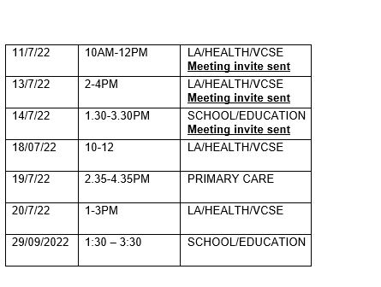

Slide 22


Slide 23


Slide 24


Slide 25
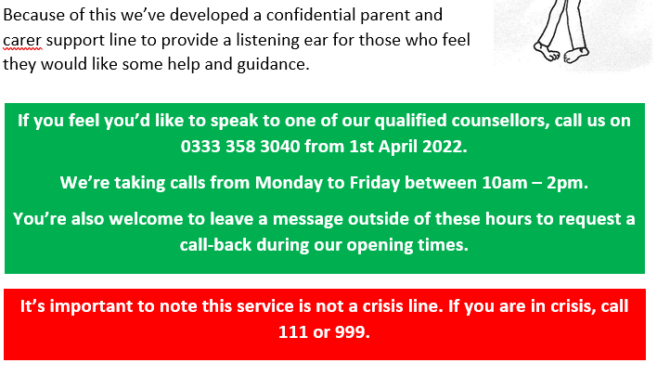

Slide 26
Question came through the parent carer forum- can a school say they cannot meet my son’s/ daughter’s needs?
Legislation is in place: Children’s and Families Act/ SEND Code of Practice/ DDA
Summary of what the Code of Practice states:
9.78 Relevant legislation: Sections 33 and 39 of the Children and Families Act 2014 9.78 The child’s parent or the young person has the right to request a particular school, college or other institution of the following type to be named in their EHC plan: • maintained nursery school • maintained school and any form of academy or free school (mainstream or special) • non-maintained special school • further education or sixth form college • independent school or independent specialist colleges (where they have been approved for this purpose by the Secretary of State and published in a list available to all parents and young people

Slide 27
9.79 If a child’s parent or a young person makes a request for a particular nursery, school or post-16 institution in these groups the local authority must comply with that preference and name the school or college in the EHC plan unless: • it would be unsuitable for the age, ability, aptitude or SEN of the child or young person, or • the attendance of the child or young person there would be incompatible with the efficient education of others, or the efficient use of resources
The school is always consulted with
Where a nursery, school or college identified at 9.78 above is named on an EHC plan they must admit the child or young person.

Slide 28
9.88 Where a parent or young person does not make a request for a particular nursery, school or college, or does so and their request is not met, the local authority must specify mainstream provision in the EHC plan unless it would be:
• against the wishes of the parent or young person, or
• incompatible with the efficient education of others
9.89 Mainstream education cannot be refused by a local authority on the grounds that it is not suitable. A local authority can rely on the exception of incompatibility with the efficient education of others in relation to maintained nursery schools, mainstream schools or mainstream post-16 institutions taken as a whole only if it can show that there are no reasonable steps it could take to prevent that incompatibility.

Slide 29
Training and Development for next academic year (to name but a few and we will be getting together in person for some ☺)
Deaf Awareness Training
ADHD/ Autism and Anxiety Awareness Training
Use of TAs in the classroom
Meeting additional needs in the classroom: a practical guide
Presentations from Specialist Settings to share knowledge
Don’t forget to take a look at Services for Schools but I will continue to keep you up to date and remember to let Michael or I know about any training that you feel would be beneficial

Slide 30
Would you like a slot on the SENCO Network?
There is so much good practice out there- would you be willing to share tweaks/adaptations made/ resources implemented in your school that you have found are working well and have made a difference.
Let Michael and I know if you would be willing to share your school’s story.

Slide 31
And finally a huge thank you to all of you for helping to support the development of the SENCO Network
Thank you for your hard work and dedication
Thank you for allowing me to come and visit your schools- it really does help me to get a sense of your school and a spring in my step
Remember Michael and I are here to help and support in any way that we can
Please remember to pass on any key messages to your Leadership teams and let us know of anything that you would like to hear about as part of the SENCO Network meetings

Slide 32
Guest Speakers for September 15th-
Andrea Riley- Behaviour Support Services
RISE- Mental Health
Carol Chilvers- HINT
Heather Jenkins- Narrative Practice
Training dates will be shared at the start of the next academic year and you will be able to sign up for a place through Services for Schools

Slide 33
Thursday 15th September 2022 3:30-5pm
Thursday 17th November 2022 3:30-5pm
Thursday 26th January 2023 3:30-5pm
Thursday 16th March 2023 3:30-5pm
Thursday 18th May 2023 3:30-5pm
Thursday 13th July 2023 3:30-5pm
Don’t forget to sign up through the Services for Schools SENCO Network page

