Slide 1
Gateshead 0-19 Growing Healthy Virtual offer during covid 19
The whole team moved on to VPN at the beginning of the pandemic
Attend Anywhere virtual clinic 4 clinics HV, School nurse drop in, Infant feeding & Emotional wellbeing
Social media presence including YouTube, Twitter and Facebook
Service user feedback –collected throughout the pandemic and continues to be collected via survey monkey

Slide 2
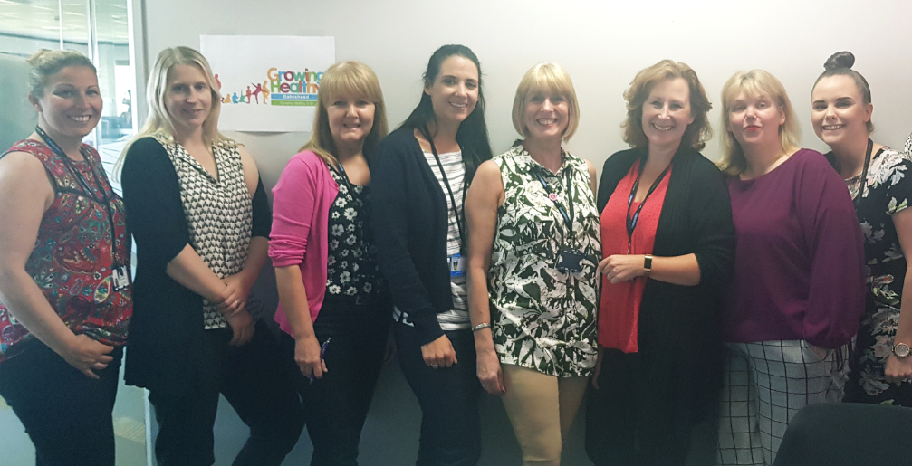

Slide 3
Breast feeding café

Slide 4
Messenger –Daily messages responded too
Facebook page reach 62K
4153 page likes
94.2% women
5.8% men
UK 98.3%
USA 0.3%
Australia 0.1%
Canada 0.1%
Biggest following across footprint! (thankyou screeners)

Slide 5
Virtual weaning sessions
All EYPs involved in the delivery
Over whelming positive service user feedback
100s of mothers invited and usually well attended
The sessions run fortnightly
Virtual presentations into schools
Delivery in to special schools to support hygiene and covid anxiety
ERN Lynsey Robson delivered to hundreds of children in multiple schools and many classes simultaneously
Band 5 delivery in to schools

Slide 6
Start Date → | 01/09/2020
 |  | Tue | Wed | Thu | Fri | Sat | Sun | Mon | Tue | Wed | Thu | Fri | Sat | Sun | Mon | Tue | Wed | Thu | Fri | Sat | Sun | Mon
 |  | 1 | 2 | 3 | 4 | 5 | 6 | 7 | 8 | 9 | 10 | 11 | 12 | 13 | 14 | 15 | 16 | 17 | 18 | 19 | 20 | 21
General Message received on Facebook |  | 1 | 0 | 2 | 0 | 1 | 1 | 2 | 1 | 1 | 1 | 0 |  |  | 3 | 0 | 0 | 1 | 0 |  |  | 1
general message Documented and actioned on Systmone |  | 0 | 0 | 0 | 0 | 0 | 0 | 2 | 0 | 0 | 0 | 0 |  |  |  | 0 | 0 | 0 | 0 |  |  | 0
virtual clinic attendance |  |  |  | 0 | 0 |  |  | 1 | 0 | 1 | 0 | 0 |  |  | 0 | 0 | 0 | 0 | 0 |  |  | 0
virtual clinic documented and actioned on systemone |  |  |  | 0 | 0 |  |  | 1 | 0 | 1 | 0 | 0 |  |  | 0 | 0 |  | 0 | 0 |  |  | 0
virtual clinic required referral |  |  |  | 0 | 0 |  |  | 0 | 0 | 0 | 0 | 0 |  |  | 0 | 0 |  | 0 | 0 |  |  | 0
virtual emotional health clinic attendance |  | 0 | 0 | 0 |  |  |  |  | 1 | 0 | 2 |  |  |  |  | 1 | 1 | 1
virtual emotional health clinic documented and actioned on systemone |  | 0 | 0 | 0 |  |  |  |  | 1 | 0 | 2 |  |  |  |  | 1 | 1 | 1
emotional health clinic required refferal |  | 0 | 0 | 0 |  |  |  |  | 0 | 0 | 0 |  |  |  |  | 0 | 0 | 0
virtual school nurse clinic attendance
virtual school nurse clinic documented on systemone
school nurse clinic required referral
no of invites to live weaning session |  |  | 10 |  |  |  |  |  |  |  |  |  |  |  |  | 14 |  |  | 13
no of attendies to live weaning session |  |  | 6 |  |  |  |  |  |  |  |  |  |  |  |  | 5 |  |  | 6
no of attendees at the breast feeding café |  |  | 0 |  | 0 |  |  | 0 |  | 0 |  | 0 |  |  | 0 |  |  |  | 0 |  |  | 0
infant feeding virtual clinic attendees |  |  | 0 |  | 0 |  |  | 0 |  | 0 |  | 0 |  |  | 0 | 7 |  |  | 0 |  |  | 0
infant feeding virtual clinic documented on systmone |  |  | 0 |  | 0 |  |  | 0 |  | 0 |  | 0 |  |  | 0 |  |  |  | 0 |  |  | 0
infant feeding clinic required referral |  |  | 0 |  | 0 |  |  | 0 |  | 0 |  | 0 |  |  | 0 |  |  |  | 0 |  |  | 0
Daily |  | 1 | 16 | 2 | 0 | 1 | 1 | 6 | 3 | 3 | 5 | 0 | 0 | 0 | 3 | 21 | 2 | 3 | 19 | 0 | 0 | 1

Slide 7
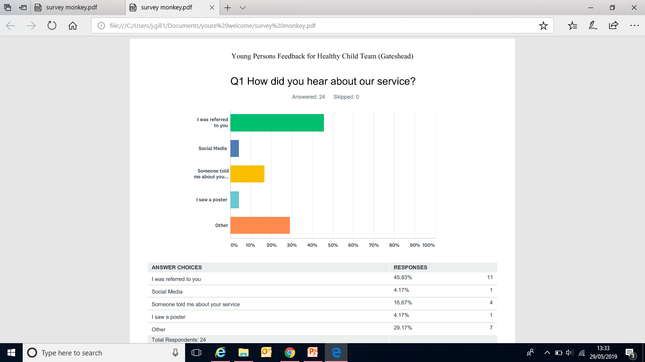

Slide 8
What does the future hold
Benchmarking attendance at virtual attendance across the foot print
Mobile app to engage service users and gather feedback
Licensed version of MST with added functionality
Gateshead chairs the SDM group and feeds back to the DID group
Any ideas ?
THANK YOU

